Slide 1
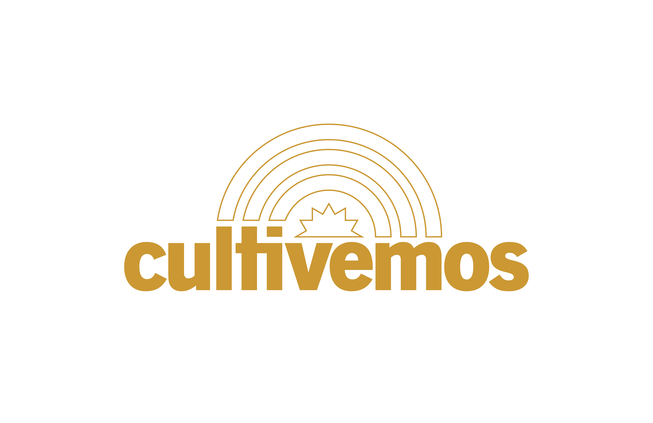
Managing Finances
Your logo here
Keeping Your Money Safe by
Using Financial Services
Presented by:
Notes:
Introduce self and title of program and your organization
Explain that Cultivemos is an organization dedicated to assisting farmers and farm workers manage farm stress.
Today we’re going to talk about financial services used in the United states to help manage money.
Note to Facilitator: Distribute the publication that goes along with this session including the important words to know and the case study.

Slide 2
Financial Services In the U.S.
Financial Services Options :
Why Use Financial Services?
Banks and credit unions are financial institutions that offer financial services. Money placed in these institutions are safe because only you or designated people on the accounts can access the money. The money is also guaranteed by the US Government.
Financial services offered by these institutions include savings and checking accounts as well as loans and credit cards
You may not feel safe carrying money around
You may be concerned about the safety of your money wherever it is located
Offer ways for you to manage and access your money
Provide an opportunity to earn interest on your money
Notes:
Turning your paycheck into cash is an easy way to make purchases. There are financial institutions where you can open an account that enables you to access your money. Two key institutions are:
Bank - financial institution licensed to receive deposits and make loans. Banks are for-profit institutions that must follow federal government rules to ensure that your money is secure. They may a profit by charging fees.
Credit Union - a nonprofit-making money cooperative whose members can borrow from pooled deposits at low interest rates. Again, the federal government has rules that ensure your money is safe. Credit unions can also charge fees but because it is a member “owned” organization, the fees tend to be less.
Financial Services - are professional services involving the investment, lending, and management of money and savings.
Savings Account – a deposit account held at a financial institution that earns interest.
Checking Account - is a deposit account held at a financial institution that allows the money to be available to the account owner for frequent and immediate access by the account owner.
Interest - money paid regularly at a particular rate for the use of money lent. For a savings account, interest is earned on money held in the account.
It is important to comparison shop among banks and credit unions to see what will work best for your needs. Things to consider include:
How

Slide 3
Should I Have a Checking, a
Savings Account or Both?
Checking Accounts
Savings Accounts
Deposit your money
Helps you manage your money
Easily access your money by using:
  A debit card
  Online payment
  Mobile payment
  Paper check
  Withdrawing cash through ATM
Deposit your money
Helps you save your money for periodic expenses and to set aside money to meet financial goals
Helps you grow your money though interest (the bank pays you to keep it in the account)
Access your money at any time
Notes:
Both banks and credit unions offer checking and savings accounts. These two types of accounts provide different ways to manage your money. A checking account helps you access your money in a variety of ways so you can pay bills and have cash for spending. A savings account is used to set money aside for future purposes and to meet savings goals. The advantage of a savings account is that the financial institution pays you to have your money. You will earn interest on your money each month. Lets go over some important words to know when it comes to these types of accounts.
Deposit - a sum of money placed or kept in a bank account. As an employee, you can usually have your paycheck automatically deposited in your account through direct deposit. You and your employer would set this up. You would need to have your bank/credit union account set up and you would provide the account number to your employer. Direct deposit means the employer automatically sends the amount to the financial institution. You would not receive cash or a paycheck. You would receive a pay stub that outlines information about your earnings and tax payments. This document would come from your employer.
Debit Card - a card issued by a bank allowing the holder to make a transfer money electronically to another bank account when making a purchase. Debit cards can also be used to acquire cash at ATM machines (Automated Teller Machine).
ATM (Automated Teller Machine) - a machine that dispenses cash or performs other banking services when an account holder inserts a bank card.
Online/Mobile Bill Payment - secure electronic service that allows customers to pay bills without having to write paper checks and mail them.
Paper Check - is used as a source of information to conduct a financial transaction.
With savings accounts you earn interest on your deposit. How much interest depends on the financial institution. You can shop around for the best rates. Some savings accounts have rules about how often you can take money out or require a minimum deposit to have the account.

Slide 4
How do I Decide Which Type of Account to Have?
Some farmworkers have both types of accounts
One for saving money
The other for using their money for expenses and paying bills
Your bank or credit union provides a record of your transactions
Monitoring this information helps you manage your money
The U.S. federal government insures money that is put into a bank or credit union
Notes:
How do you decide?
Many people in the US have both a savings account and checking account. Money is deposited into the checking account and then some funds are moved to or deposited into the savings account to help reach financial goals, save for periodic expenses or to have some money set aside for unexpected expenses or emergencies. One of the advantages of having a financial account is that transactions which is a financial agreement carried out between a buyer and a seller to exchange a product or service for payment are monitored and you will receive a statement of these actions.
Some farm workers have both types of accounts to manage their money. – one for saving and one for using their money to pay expenses and bills. Here are some questions to consider when deciding what will work best for you:
Determine how often you might need to pay bills and how you pay them.
Do you have a secure way to track how and when you pay bills?
Do you get receipts for your payments?
A checking account can help to document your payments so you have proof you paid and how much.
How do you want to access your money? As we’ve learned there are a variety of ways to access the money in the account, think about the best way you need to access funds.
How expensive will it be to have an account. You will want to compare the cost of managing funds and the safety of those funds compared to the way you are managing those funds now. For example, how much does it cost to cash a paycheck and can you keep track of the cash once you have a pocket full? How much does cash checking service cost compared to having a checking account? Compare fees across accounts.
With respect to a savings account do you want to have money for unexpected and periodic expenses? If you have just a checking account, will you be able to not spend it all and set aside money for future expenses? Many people open a savings account so they don’t “touch” the money until needed.

Slide 5
How Do I Decide Which Type of
Account to Have?
How Will You Use Your Money?
  for saving money
  for paying for your purchases and bills
  for sending money to family overseas or your home country
  You may want to have both a savings and checking account if you have all these needs.
Notes:
Ultimately to decide which type of account(s), think about how you need to access and use your money and if you have savings goals.
If you are just spending money then just a checking.
If you need to save money then both.
Ask, which account do you think would work best for you? What would make managing your money easy?
Aski, are there questions about these two types of accounts?

Slide 6
What do I Need to Do to Work With a Bank or Credit Union?
When you open an account you become a customer (for a bank) or a member (for the credit union)
The bank or credit union will need to:
  verify your name
  date of birth
  address
  I.D. number
An ID number can be
  a social security number (SSN)
  or an Individual Taxpayer Identification Number (ITIN)
Some institutions will accept a
  passport number and the country of issuance
  an alien identification card number
  other government-issued I.D. number
Talk to your employer about identification; they must complete forms to provide you with a paycheck.
Notes:
For most banks and credit unions you become a customer or member once you open an account. To open an account you will need to verify your name, date of birth, address and id number. You may also provide an email so that they can send you statements via email. Depending on the institution they may accept different types of ID numbers. These include a social security number, a Individual taxpayer identification number or other government issued identification. You may need to visit different banks or credit unions to find out what types of accounts they offer, and what types of I.D. numbers they accept. Work with your employer to find the local institutions you can work with.

Slide 7
Questions to Ask Before You Open an Account
Fees
Deposits
Some banks/credit unions offer free accounts, while others charge fees.
Are there Monthly Fees or Service Charges if you don’t meet the Minimum Balance requirement on the accounts?
Are there fees for accessing ATMs or for using Online/Mobile Banking?
Is there a fee for using your debit card outside of the U.S.?
If so, how much is charged and when is it charged?
Ask what the options are for making a deposit
Most employers will be able to set up a direct deposit so your paycheck goes into your checking or savings account
If not, you’ll have to travel to the bank/credit union to make the deposit
Does the institution have mobile banking?
Does the bank offer mobile deposits via your phone and their app?
Notes:
We’ve talked already a little about the types of questions yo might ask to help decide which financial institution of account to have but lets go a little deeper. To decide which type of account(s), think about how you need to access and use your money and if you have savings goals. Some information you will want to ask about are the following important words to know:
Minimum Balance - a minimum amount of money that needs to stay in the account in order to maintain the account or not pay fees.
Monthly Fees or Service Charges - a fee collected to pay for services related to the primary product or service being purchased; in this case it would be use of an account.
Mobile Deposit - is a way to deposit a check without physically going to the bank. Using a mobile device with a camera—such as a smartphone or a tablet—it's easy to take a picture of the check, which is then uploaded through the bank's mobile app.
Online/Mobile Bill Payment - secure electronic service that allows customers to pay bills without having to write paper checks and mail them.
Direct Deposit - the electronic transfer of a payment directly from the account of the payer (employer) to the recipient's (employee’s) account.
Who can be on your account? Can you share the account with loved ones in your home country?
Remember that you can always close the accounts when you leave the U.S.
Make the most of your money by choosing an account that best suits your needs.

Slide 8
Meet Dani - A Case Study
Dani came to work in the United States and now has a job as a farmworker.
Dani does not know what to do with the cash they have from their paycheck.
Dani sends some of their money back home to the family but still has cash to keep with them to pay for expenses.
Dani heard about other workers having money stolen from them and is worried that something might happen to their cash
Notes:
Let’s meet Dani who is a farm working in the US. We are going to review this case study to learn more about options Dani will make about using a financial institution.
Dani came to work in the United States and now has a job as a farmworker.
Dani does not know what to do with the cash they have from their paycheck.
Dani sends some of their money back home to the family but still has cash to keep with them to pay for expenses.
Dani heard about other workers having money stolen from them and is worried that something might happen to their cash

Slide 9
Meet Dani - A Case Study
A friend, Juan, shares that Dani can open a bank account even if he/she doesn’t have a social security number.
Juan has been in the U.S for a while and suggests that Dani thinks about how they want to use their money, what services they would like to use, and what type of account is wanted.
Juan helps Dani decide that accessing money whenever it is needed would be helpful.
Dani wants to save some money for emergencies and for traveling home to visit family and to transfer money home easily.
Dani want to keep as much money and doesn’t want to pay a lot in fees.
Juan helps Dani make a list of important things they want from their bank account and to compare information from two banks in town.
Notes:
Continue to read through the case study

Slide 10
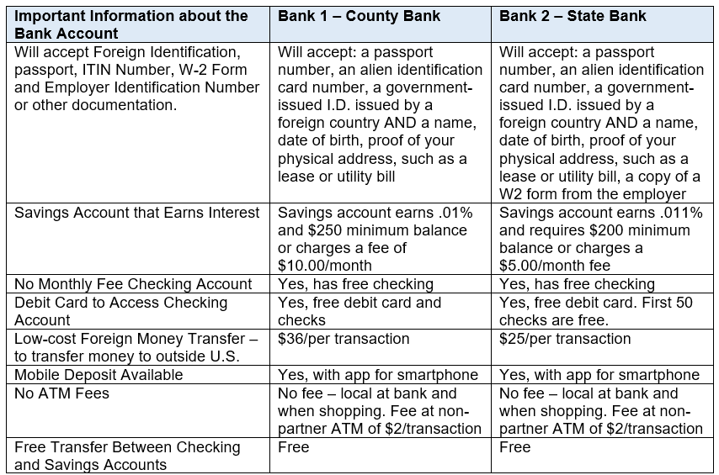
Comparing the Two Financial Institutions
Notes:
Discuss slide
Compare and contrast the Banks.
Why would one be better over another for Carlos/Isabella?

Slide 11
What Does Dani Decide?
Dani decides to open a savings and checking account with State Bank because the money would earn more interest and there are fewer fees.
Dani used a passport and government I.D. to open the accounts.
Dani uses the debit card from having a checking account to pay for groceries, buy things online and get cash from the bank’s ATM when needed.
Dani is glad to have opened a saving account. The money is safe and can be accessed it when needed.
Dani’s employer helped to set up a direct deposit to put some money in both accounts each month. This has really helped to save money for later use.
Also having these accounts saved money on transfer fees when sending money to their home country.

Slide 12
Finding the Right Financial Services-
Bank or Credit Union
Now it is your turn to find the right bank or credit union to provide you with a bank account and the tools you need to manage your money safely.
Use this chart to compare two different banks or credit unions.
Use the criteria in the chart and add others that you think are important.
Call, visit or do an internet search for the bank/credit union to get the information you need.
Once you find out the information about each one, choose the bank or credit union to help you reach your financial goals.
Based on this information, which bank or credit union will you choose?
Notes:
Use the handout and review the materials to assist participants in help understanding how they can use it to comparison shop between financial institutions.
Note to facilitator: A copy of the form is on the next slide.
Activity, bring to the workshop some information from a few banks /credit unions in town and have participants review the materials to see what information is provided. Have them use the information to fill out the handout.
Alternatively, you could invite a representative from those institutions to present information to the group.

Slide 13
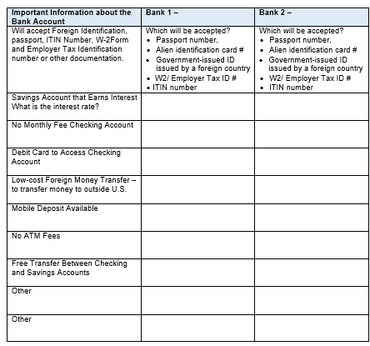
The Right Financial Services
Notes:
You’ll be given a copy of this to take home.

Slide 14
Today’s We Reviewed:
Important words to know about financial institutions and accounts in the U.S.
Understanding banking institutions like banks and credit unions
Understanding checking accounts and savings accounts as tools to help manage your money and keep it safe
Learning about how to choose a financial institution and account that best suits your needs and goals.
What questions do you have?

Slide 15
Thank you for attending our program
Please use the evaluation tool we provided to help us know how well we did in providing you information.

Slide 16
Resources
Farm Aid – Call 617-354-2922 from 9 am to 5 pm eastern; they have Spanish speaking personnel
Cooperative Extension in your county – go to https://www.uaex.uada.edu/about-extension/united-states-extension-offices.aspx and type in your state and county to find your local office.
Cultivemos - https://www.youngfarmers.org/cultivemos/
Consumer Financial Protection Bureau – lots of information about banking, credit, and financial management https://www.consumerfinance.gov/
Notes:
Feel free to add local resources

Slide 17
Additional questions?
Insert your contact information here

