Slide 1


Managing Finances In the United States
Creating a Spending Plan
Your logo here
Presented by:
Notes:
Introduce self and title of program and your organization
Explain that Cultivemos is an organization dedicated to assisting farmers and farm workers manage farm stress.
Managing Finances in the United States is a series of programs that help individuals who are not familiar with US. Financial systems.
Todays topic is about creating a spending plan so that you can better organize and manage your hard earned income.
Note to Facilitator: Distribute the publication that goes along with this session including the important words to know and the case study.

Slide 2
Managing Finances
Creating a Spending Plan
Why Create a Spending Plan?
Ensure that you can:
  cover your basic living needs
  care for your family
  purchase items you want
  pay financial obligations or debts
Notes:
Planning on how to spend your hard-earned dollars is important. With a bit of planning, you can allocate your dollars effectively to achieve your goals and meet your expenses. Here are the definitions for these three important ways we spend our money.
Needs – items or circumstances that are necessary and required for health, financial security, and safety.
Wants – items or circumstances that are desired.
Obligations - An obligation is the responsibility to meet the terms of a financial contract. If an obligation is not met, the legal system often provides recourse for the injured party. Examples include debt or rent.
Ask: Can you provide examples of each of these?

Slide 3
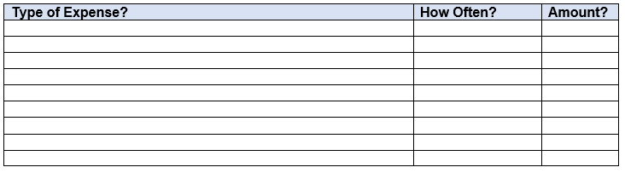
What Type of Expenses Will I Have?
Write Down Your Expenses
What type?
    Fixed expenses - stays the same each month (Examples: car, rent)
    Flexible- changes depending on your spending (Examples: food, gas, medical)
    Periodic- happens only occasionally throughout the year (Examples: car inspection, haircut)
    Unexpected – unplanned expenses (Examples: doctor’s visit, car repairs)
    Spending Categories – are groupings of similar types of expenses (Examples: debt, savings goals, medical, utilities, insurance)
How often do these expenses occur?
    Weekly-gas, food
    Monthly- car payment, rent
    Quarterly- car insurance, life insurance
Notes:
Developing and following a spending plan will help you best manage your money.
Some expenses will be easy to know right away and some will be an estimate of how much you spend. The more precise you can be, the better your plan will help you manage your finances.
Here are the definitions of different financial terms we use in the US.
Fixed Expense - An expense that is consistent and recurring and usually is a necessity. It may be the same amount each month or it may vary but you know there will always be this expense.
Flexible – an expense that can change from month to month; it could be the amount that changes or it may not occur each month. This type of expense may or may not be something that can be reduced or eliminated from a spending plan.
Periodic – an expense that happens occasionally throughout a year.
Unexpected – an expense that you did not plan for.
Spending Categories - means a grouping of similar expenditures within the spending plan. Examples include insurances, medical costs, savings goals, or utilities where you might have more than one type of expense under each title.
Ask: Can you think of other expenses you have? What type of expense is it and how often do you have this expense?
Writing down your expenses helps you understand where your money is going and helps you to take control of your expenses. Once you know where it is going , you can make deliberate decisions about where you want it to go.
It is important to set aside money ahead of time for periodic expenses so you have the money when you need it. The same goes for the unexpected. Setting a little aside can relieve financial stress and allow you to be prepared to handle the unexpected.
Activity: Using the publication, have participants start to identify the expenses they have and how often they have them.

Slide 4

Meet Dani - A Case Story
Dani lives in the U.S part-time and has family in his/her home country. Dani has come to the U.S. to help support his/her family and pay down some debt that occurred coming to the United States. Weekly gross wages are $450.
Dani shares a house with other farmworkers; they share the housing expenses. One of the housemates owns a car and often drives Dani to the store or into town when needed. Dani contributes by helping to pay some of the gas cost each week.
Food can be prepared in the home; sometimes the housemates cook together, and sometimes they prepare meals for breakfast, snacks, and lunch for just themselves.
Two months ago, Dani hurt his/her back and had to go to the doctor for a visit and medicine.
Dani wants to go home during the off-season to see his/her family and knows there will be transportation costs and gifts to purchase for family. There are other expenses too.
Notes:
We wanted to give you an idea of how this might look for a farm worker. Here is a story about Dani. We’re going to use Dani’s information to learn a little about creating a spending plan.
Read the slide

Slide 5
How Do I Create a Spending Plan?
Start by Gathering Spending Information
Choose your spending plan based on the week, pay period, or monthly time frame.
Find or create a tool to help you organize your spending plan. (A monthly plan is in your packet).
Identify your income from all sources.
Identify the expenses that are deducted or automatically taken out of your pay. This may include taxes and employer benefits (for example, health insurance or disability insurance).
List the types of fixed expenses and obligations and the amounts.
List the types of flexible expenses and the estimated amount you need to save for your needs and your goals. Examples include food, gas for a vehicle, clothing or unexpected costs like health care costs, auto repairs, or savings goals like travel home to visit family.
List the expenses and the amounts you need to set aside for periodic expenses that you know you will have. Examples could include medications, clothing, auto repairs, or auto insurance.
Notes:
There are steps you can take to create your own spending plan. On this slide are the steps. Review the steps
Next we’re going to look at how Dani gathered the spending information

Slide 6
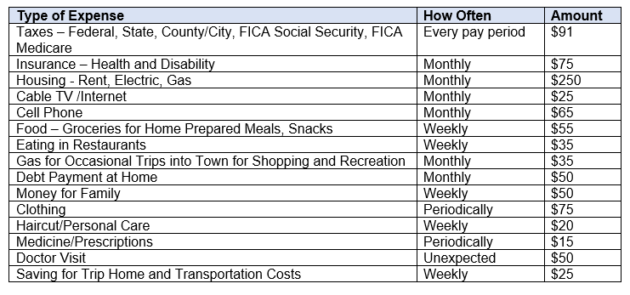
Dani Wrote Down Expenses
Organized in Spending Categories:
Notes:
Spending Categories - means a grouping of similar expenditures within the spending plan. Examples include insurances, medical costs, savings goals, or utilities where you might have more than one type of expense under each title.
Based on Dani’s story, we can see where his money is going and how often. This slide offers a way to organize spending based on spending categories. We can see how Dani spends the money earned.

Slide 7
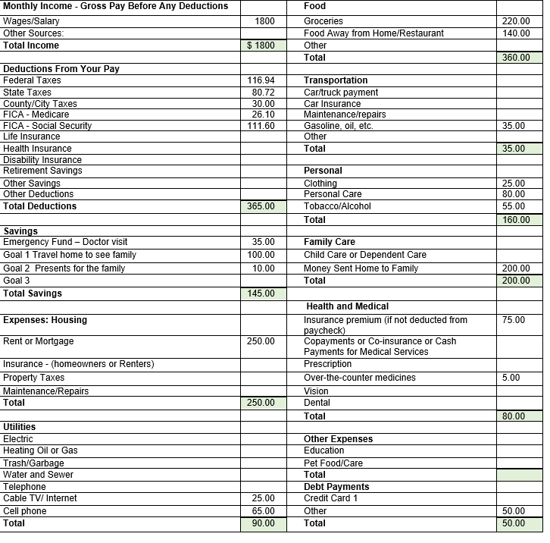
Dani’s
Monthly Expenses
Notes:
Based on the list of expenses that Dani wrote down, the following monthly plan was created. We used the monthly handout offered in your packet and filled it in using Dani’s information.
The periodic expenses were estimated based on how often that expense occurred, and a monthly amount was created. By determining how much could be set aside each month so that when the expense occurs, the money will be there to pay that expense. For example, if car insurance is $600 every 6 months, then $100 should be set aside each month so that there is enough money to pay this bill when it needs to be paid.
It is best if money is saved for these periodic expenses, so you have it when you need it. This helps to reduce financial stress and ensures bills are paid on time so there are no finance charges, delinquency charges or repossession of items (all this depends on the type of expense/bill).

Slide 8
Creating A Spending Plan
Next - Compare Your Income with Your Expenses
Total Income – Total Deductions – Expenses – Savings – Debt Payments =
Remaining Amount
Notes:
Having created the spending plan, now it is time to compare your income with your expenses to be sure we are spending and savings are within our earnings.
Use the calculation to help you see if you need to make adjustments to how you spend money.
Use the total amounts from filling out the monthly plan to complete this calculation.
You will need to add all the expense categories to fill in the “Expenses” in this calculation.
Now subtract all the different expense categories from your gross income to see how much money you have remaining.
If you have more expenses than income, decide which expense categories need to be reduced to prevent overspending. Or you might try to make some additional income
If you have more income than expenses, decide how to spend or save this money. You might add additional expense categories like gifts for family or choose to pay more towards your debt or save for unexpected expenses.
By creating a spending plan, you control where your money goes. It can help you be successful in accomplishing your goals, paying down debt and feeling more confident in your money management

Slide 9
Case Story: Comparing Income with Expenses
$1800 - $365 - $1175 - $145 - $50 = $65
Total Total Debit Remaining
Income – Deductions – Expenses – Savings – Payments = Amount
Based on this monthly spending plan, Dani has $65 that could be used to save more money, pay more towards debt, or use for other spending categories.
Notes:
Here is the example based on Dani’s earnings and spending. Based on this monthly spending plan, Dani has $65 that could be used to save more money, pay more towards debt, or use for other spending categories.

Slide 10
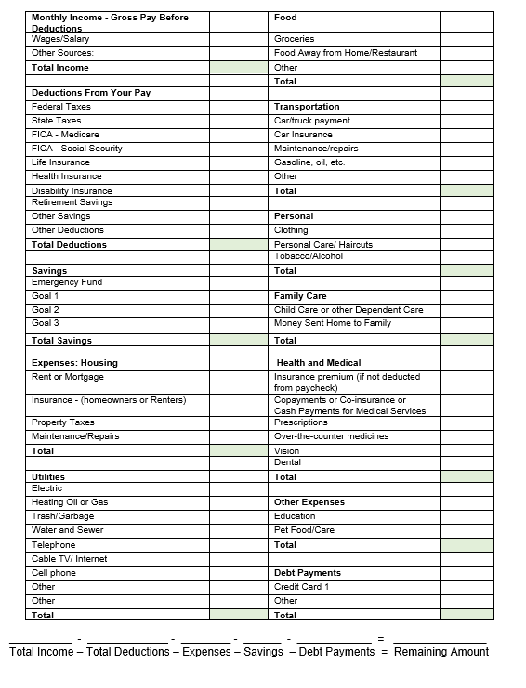
What Will Your Spending Plan Look like?
Notes:
What would your spending plan look like? You have been given a copy of this monthly spending plan to take home.
This worksheet was designed to help you remember all the places you spend money. There may be categories listed here that you won’t use; you don’t have that expense. It is ok to leave them blank.
As you can see, there are places for fixed, flexible, obligations, periodic expenses as well as savings goals. There is a green box where you can add up each category to see what the totals are.
There is also a place where you can identify your income sources.
At the bottom of the sheet there is a place where you can calculate any remaining amount you have to spend after you deduct expenses from your income.
What questions do you have about this worksheet?

Slide 11
Today we reviewed:
Important words to know when managing your money in the US.
How to create a spending plan.
What questions do you have?

Slide 12
Thank you for attending our program
Please use the evaluation tool we provided to help us know how well we did in providing you information.

Slide 13
Resources
Farm Aid – Call 617-354-2922 from 9 am to 5 pm eastern; they have Spanish speaking personnel
Cooperative Extension in your county – go to https://www.uaex.uada.edu/about-extension/united-states-extension-offices.aspx and type in your state and county
Cultivemos - https://www.youngfarmers.org/cultivemos/
Consumer Financial Protection Bureau – lots of information about banking, credit, and financial management https://www.consumerfinance.gov/
Notes:
Feel free to add additional local resources

Slide 14
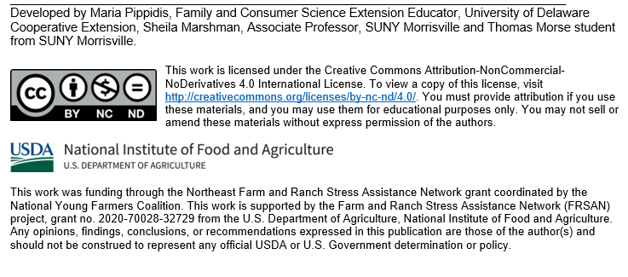
Acknowledgements:

