Slide 1

Your logo here
Managing Finances in the United States
Accessing Health Care Services and
Health Insurance Basics
Presented by:
Notes:
Introduce self and title of program and your organization
Explain that Cultivemos is an organization dedicated to assisting farmers and farm workers manage farm stress.
Today’s topic is how to access health care services and understanding health insurance in the United States.
Medical care in the US is expensive. To help cover some of the costs of health care, health insurance may be provided by your employer or purchased through the health care marketplace in your state.
Most hospitals and health centers do not require residency or immigration status documentation and will help anyone. How much it costs you to visit the doctor will depend on the health care services you used.
Today the presentation will provide an overview of health care services and insurance in the US.
Note to facilitator: Distribute publication

Slide 2

Taking Care Of Yourself is Important!
Where Can I Go for Medical Treatment?
A Doctor’s Office
A Specialist’s Office
Laboratories
Urgent Care Clinics
Hospital
Emergency Services at a Hospital
Notes:
In the U.S. health care is provided through hospitals, urgent care clinics, and local doctors.
There are doctors who are generalists, primary care physicians or family doctors who treat people in over time.
There are also specialists who focus on certain illness or ailments such as diabetes or heart disease.
There are laboratories that can be visited that take blood samples, X-rays or other tests that are prescribed by your family/primary care doctor or specialists to help better understand your illness.
There are hospitals that offer services like emergency room services, general and specialty surgical services, x ray/radiology services and laboratory services
Many hospitals have emergency care facilities. And these are the locations one visits when something really awful or life threatening happens like a heart attack or vehicle accident.

Slide 3
Taking Care Of Yourself is Important!
Where Can I Go for Medical Treatment?
Federally Qualified Health Centers (FQHC) are community-based health care providers that receive federal funding to provide primary care services.
Locally these centers may be called Community Health Centers or Migrant Health Centers.
You must provide Information about family size, photo identification, address, and proof of income when using these facilities.
You can go to these centers for any reason - illness or injury.
Find your closest Federally Qualified Health Centers using this tool: https://findahealthcenter.hrsa.gov/tool
Notes:
Your health is an important asset. Without your health you can’t work, be with family or live life to the fullest. If you are sick or injured, working and caring for your family is more difficult. It is important to know, where you can get the treatment and how you will pay for medical treatment. In the U.S. there are Federally Qualified Health Centers. These are community-based health care providers that receive federal funding to provide primary care services. You will need to provide information about you but you can’t be turned away. Often time, there are payment plans to help you cover the costs of care over time.
Find your closest one using this tool: https://findahealthcenter.hrsa.gov/tool

Slide 4
What Will it Cost If I Don’t Have Insurance?
When a sliding scale fee payment system is used, the health care provider will use a formula based on your income and family size to determine how much you must pay and set up a payment plan to pay the bill over time.
The hospital staff will request your medical history to help assess your medical needs. The hospital will mail you an invoice. Thus, you must provide your name and address. You must also give Information on your income level so the hospital can bill you the correct amount.
Notes:
How much health care costs you will depend on the health care services you use. At some hospitals and clinics, they use a sliding scale payment system to determine how much they will charge. In addition, they may ask you questions about your health so that they can best treat your illness or injury.
Note to facilitator: review the important words to know
Sliding Scale Fee – the scale offers variable prices for products or services based on a customer's ability to pay.
Health Care Provider - is an individual health professional or a health facility organization licensed to provide health care diagnosis and treatment services

Slide 5

Who Covers the Costs if I Get Injured?
If you are injured on the farm while working, your employer may have a type of insurance for you called Workmen’s Compensation. This type of insurance only comes into play when you are injured while working; it covers lost wages and medical bills in exchange for your giving up your right to sue your employer. Check with your employer to be sure you are covered.
If you do not have health insurance, you will pay all the costs of medical care. Using a health care facility that uses a sliding scale fee will save you money.
If you do have health insurance, then you share the cost of health care with your health insurance plan company and maybe your employer.
Notes:
Who covers the cost of an injury. It depends a bit on the circumstances. If you are injured while on the job, most employers have workman’s compensation or workman’s comp insurance. Workers' compensation or workers' comp is a form of insurance providing wage replacement and medical benefits to employees injured in the course of employment in exchange for mandatory relinquishment of the employee's right to sue his or her employer for the tort of negligence. You want to talk with your employer about whether they have this insurance for you.
If you do not have health insurance, then you will pay the cost. So it is best to shop around for the best health care facility before there is an emergency.
If you have health insurance, then you share the cost of medical care with the health insurance plan company.
Let’s talk a bit more about health insurance.

Slide 6

What is Health Insurance?
Health insurance or medical insurance is a type of insurance that covers the whole or a part of the risk of a person incurring medical expenses.
When you pay for and use your health insurance policy, the insurance provider and you then shares the medical costs.
Notes:
In the U.S. health insurance is often either provided by the employer or is purchased on the health care marketplace. Health insurance is a tool people use to manage potential unknown costs when becoming sick, injured, or developing a chronic health condition, by purchasing and paying for health insurance. When you pay for and use your health insurance policy, the insurance provider and you then shares the medical costs.
The way it works is that there is a monthly fee for having the insurance policy that you or your employer pays. The policy then provides benefits like accessing health care services at a lower rate, sharing the cost of the care with them and some prevention services offered for free – like an annual visit with your family doctor.

Slide 7
How Do I Get Health Insurance?
Some employers offer health insurance as an employee benefit.
  The costs of health insurance could then be shared with your employer; you would receive a health insurance card and some information about the plan.
Most states have a Health Insurance Marketplace.
  This program makes it easy to access health insurance. The amount you pay for insurance will be based on your income and family size, ages, and if there are smokers in the family. Based on the Information you provide, you may qualify for financial help or subsidies that reduce the monthly premium cost.
Notes:
Facilitator notes: review the content of the slide and the important words to know below:
Employee Benefits - are a form of compensation paid by employers to employees over and above regular wages. Examples include healthcare or health and/or disability insurance premiums.
Health Insurance Marketplace - is a place (both online and in-person) where consumers in the United States can purchase private individual/family health insurance plans and receive income-based subsidies to make coverage and care more affordable. (https://www.healthcare.gov/)
Subsidy - a sum of money granted by the government to assist an individual so that the price of a product or service remains low or competitive.

Slide 8
Who Can Get Health Insurance?
U.S. born citizens
U.S. naturalized citizens
Lawfully present immigrants (like H2A workers)
Those considered U.S. residents for tax purposes are eligible for coverage through the Health Insurance Marketplace®
Undocumented immigrants are not eligible to buy health insurance from the Health Insurance Marketplace. But they may apply for coverage on behalf of documented children or family members.
Notes:
Note to Facilitator: Review this slide information
Health Insurance Marketplace - is a place (both online and in-person) where consumers in the United States can purchase private individual/family health insurance plans and receive income-based subsidies to make coverage and care more affordable. (https://www.healthcare.gov/)
Activity Note: Facilitators could bring up the website for your state/location to show participants how to find out more about the marketplace plans. You could also invite a health insurance marketplace navigator/assistor to the program to help people enroll in plans.

Slide 9
What About Dental Care?
Dental care is important to your health.
Dental care is not usually covered by health insurance.
Some clinics offer free or low-cost dental care and emergency care. You can find a local provider on this website: https://www.authoritydental.org/toothwisdom.
Some employers offer dental insurance as an employee benefit.
If they don’t, you can use the Health Insurance Marketplace to find a dental insurance plan.
This will have a monthly premium, copayments, coinsurance, and deductible costs as well.
Notes:
If you have problems with your mouth or teeth, it can be painful and impact other aspects of your health and wellbeing. It is important to take care of your teeth. In the U.S. there are dentists who can help you keep your mouth and teeth healthy. Ask your employer to connect you to a dentist in your location especially if you are having trouble with your teeth or have pain in your mouth.
Note to facilitator: review content of slide and review words to know below if need be or say that the types of costs for dental health insurance plans are similar to health insurance plans.
Monthly Premium - monthly fee paid to an insurance company or health plan to provide health coverage.
Deductible - is a set amount of money that an insured person must pay out of pocket every year for eligible healthcare services before the insurance plan begins to pay any benefits. Many plans allow access to preventative services without having to pay the deductible first.
Copayment - is a fixed amount for a covered service, paid by a patient to the provider of service before receiving the service.
Coinsurance - the percentage of costs a patient pays for cost of health care services.
Comparison Shop - compare the price of products or services from different vendors before buying.

Slide 10
How Do I Use Health and Dental Insurance?
The first step is to learn about your insurance plan.
  There will be an Evidence of Coverage document or website that provides this Information.
  Review the costs of different types of health care costs and any guidelines for accessing care.
Determine which doctors and hospitals you can use that are in partnership with the insurance company. This is called a network.
  You’ll want to visit your doctor at least once per year for an annual checkup. This visit is free.
Know where to go before becoming sick or injured.
  It is best to have this figured out before you need assistance.
Notes:
Using your insurance helps to keep you well. So it is important to understand what services are provided, who provides them and how much the copayment or coinsurance and deductible will be. There is a document provided for each health insurance plan entitled a Evidence of Coverage. An Evidence of Coverage Document - is the legal contract between you and the Health Insurance company. It outlines what services are covered and the costs, explains how the plan works and what you can do if you have questions or concerns.
We recommend getting a copy or reviewing the document before you need health care services. That way you know what to expect and where to go before you need to use them. For example, identify who your primary care doctor will be. Make an appointment for a check up and go see them. This will allow you to create a relationship with them before you have an illness or injury. Ask your employer or friends for ideas about who might be a good doctor and then check with your insurance plan to see if they cover that doctor’s costs.
Know where to go before you get hurt. Again, look at the health insurance Evidence of Coverage, call the health insurance plan member services phone number or talk with your employer about what hospital emergency rooms or urgent care facilities there are nearby so you know where to go before anything happens. Put important phone numbers in your cell phone so you have the information on hand in case of emergency.

Slide 11

How Does Health Insurance Work?
A health insurance company often has several plans to choose from. Though the different plans may offer they same types of services, the costs may be different.
Costs can include a monthly premium or payment, a deductible, copayments, or coinsurance charge.
All these different costs will be determined by the plan you choose.
Often the higher the premium the lower the other charges. It is important to comparison shop.
Notes:
There are different kinds of health insurance plans that offer health care services. There is a standard set of benefits for plans meaning all plans must offer some level of cost share for each of those services. But different plans cover the costs differently. For example, one plan may have a high deductible and low monthly premiums and co-payments while a different one might have a low deductible and higher monthly premiums.
Health insurance companies have contracts with hospitals, doctors and laboratories. This is called the network. The insurance company has negotiated the rates with the health care providers to determine what they will charge. When someone with insurance goes to visit those health care providers, the negotiated rates are charged. The health insurance company pays some of the cost and you pay some of the cost.
There are different kinds of costs.
Facilitator note: Review the costs listed here:
Monthly Premium - monthly fee paid to an insurance company or health plan to provide health coverage.
Deductible - is a set amount of money that an insured person must pay out of pocket every year for eligible healthcare services before the insurance plan begins to pay any benefits. Many plans allow access to preventative services without having to pay the deductible first.
Copayment - is a fixed amount for a covered service, paid by a patient to the provider of service before receiving the service.
Coinsurance - the percentage of costs a patient pays for cost of health care services. Usually if you pay a co-payment there will not be co-insurance charges.
Comparison Shop - compare the price of products or services from different vendors before buying
If your employer has provided you with insurance, ask them for information about the insurance plan that covers you. You could also find out the website of that company to see who are the doctors, hospitals and labs that are associated with the plan. Many health insurance companies also offer help lines to assist you in finding the right kind of help.

Slide 12
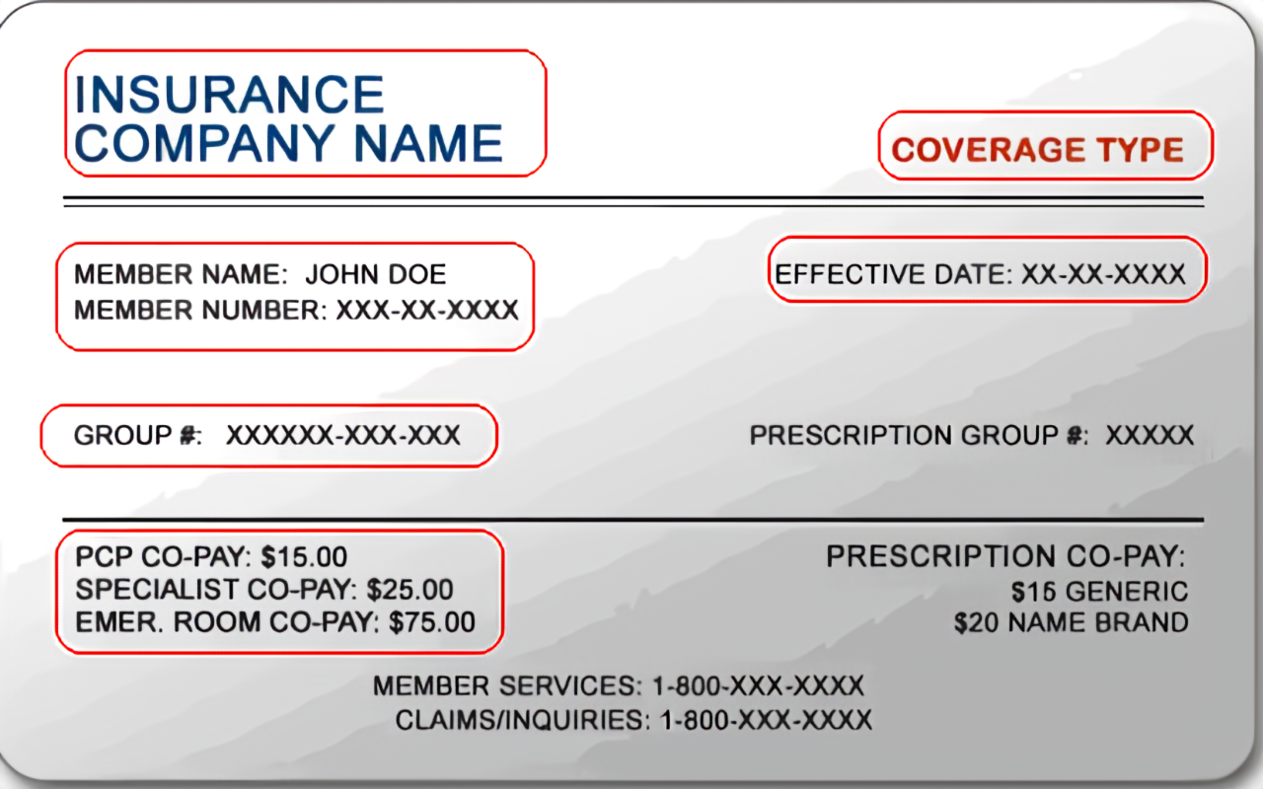
How Do I Use Health Insurance?
Pay your monthly premium to ensure you have insurance coverage for the health services you use.
You will receive a health insurance card and you should carry this with you at all times.
Find doctors and health care services that are part of the health insurance plans network.
When you need health care services, you will show this card to the health care provider.
You may have to pay all the costs until the deductible is met. This is not the case for prevention services like annual check ups.
Pay a copayment amount when you visit the doctor or laboratory.
Sample Insurance Card
Notes:
Once you choose a plan and have insurance you will pay your monthly premium to ensure that you have coverage for the health services you use.
Once you have health insurance, you will receive a health insurance card. There is important information on this card, including your policy type and number, information about copayment amounts, co-insurance amounts, and health insurance contact information.
When you need health care services, you will show this card to the health care provider. When you go to a health care provider, there may be a copayment amount that you must pay at the time of the visit. This amount will be on the card.

Slide 13
How Does Health Insurance Work?
After your visit is over, the health care provider will send Information to the health insurance company about the services, the cost, and how much you paid them as a copayment.
The health insurance company will pay the health care provider the rest of what is owed to the provider.
If you went to a health care provider who was not part of the health insurance company’s network, there might be additional charges that the health insurance company did not cover, and the health care provider might bill you. For this reason, it is essential to see health care providers who are in your network.
Notes:
Note to facilitator – review the slide

Slide 14

How Do I Use Health Insurance?
After the health insurance company pays the health care provider, you will receive a document to explain what the health insurance company paid. This is called an Explanation of Benefits document.
You will want to review Explanation of Benefits documents to ensure the services you used, and the fees are correct.
If they are not, visit with your health care provider or health insurance company to find out why there are differences.
Notes:
Note to Facilitator: Review the slide
Explanation of Benefit Documents - is the health insurance company’s written explanation regarding the health care services information a health care provider sends to them, summarizing the services provided, what health insurance company paid and what the patient must pay.

Slide 15

How Do I Use Health Insurance?
Sometimes, healthcare services don’t require a copayment but instead require you to pay coinsurance or a percentage of the bill.
For example, if the total cost of the services is $100 and the coinsurance amount is 15%, then you owe the health care provider $15 while the health insurance company would pay $85.
Notes:
Copayment - is a fixed amount for a covered service, paid by a patient to the provider of service before receiving the service.
Coinsurance - the percentage of costs a patient pays for cost of health care

Slide 16
Meet Dani - A Case Study
Dani earns $15.00 per hour and works 60 hours each week, and lives in the U.S all year.
Dani is married with three children and does not earn money from other jobs. Dani’s annual gross income is $46,800.
One day Dani was in an accident in town and broke an arm. He was not working at the time.
To address this injury, Dani went to the local Federally Qualified Health Center where an X-ray was taken, surgery was conducted, anesthesia was used during the surgery, a cast was used to stabilize the arm after the surgery, pain drugs were provided and 2 follow up visits were attended to check on the surgery and remove the cast.
Without insurance or any assistance from the Health Center, the total cost of this one event was $9,352.
Notes:
Review the case study story

Slide 17
Meet Dani - A Case Study
Scenario 1 –
Working with the Federally Qualified Health Center, Dani provided the required documentation proving income, family size, and address.
Using the sliding scale fee formula, the billing department concluded that Dani would be required to pay $20 for each visit (3 x $20= $60) and 30% of the total bill (.30 x $9,352 = $2,805) for a total of $2,865.
The Health Center worked with Dani to develop a payment plan of $150/ month for about 19 months.

Slide 18
Meet Dani - A Case Study
Scenario 2 –
Health Insurance Marketplace – For a family of 5 for a mid-ranged (Silver Plan), the cost per month would be $1500/month for all family members.
But based on the income, family size and residence location information, the income is equal to 151% of the poverty level. This level is used to determine how much subsidy you will receive.
This means Dani is eligible for financial help through the Health Insurance Marketplace.
An estimate of their cost for coverage and amount of financial help in 2022 would be estimated to be $1,479 per month ($17,754 per year) as a premium tax credit. This covers almost 100% of the monthly premium costs and means the actual cost could be $1/month for a total of $14/year, depending on the chosen Silver plan.
Total out-of-pocket costs would be limited to $5,800 in 2022. There would be a deductible of $1500 to be paid and copayments for the three visits to the health care services.

Slide 19
Meet Dani - A Case Study
Scenario 2 continued
In the case of this accident, the total cost would be $14/year for the health insurance premium + $1500 deductible + 3 x $25/visit deductible for a total of $14 + $1500 + 75 = $1,589.
After talking with the health care center, a payment plan of $150/month was developed for 11 months.
The added benefit of this scenario is that the whole family will be covered by health insurance for any future preventative doctor visits, sickness, or illness.

Slide 20
Which Scenario Would You Choose?
Notes:
Ask participants to share which scenario they would choose and why?
Ask if they have additional questions.

Slide 21
Resources
HealthCare.gov – the federal government website that provides unbiased information about health care coverage and the health insurance marketplace. Beware of imitators who want to sell you insurance!!! https://www.healthcare.gov/
Find a federally qualified health care center here: https://findahealthcenter.hrsa.gov/
Health Insurance 4 U – a free University of Delaware Cooperative Extension self study on health insurance and the marketplace. It can be found here: https://www.udel.edu/academics/colleges/canr/cooperative-extension/nutrition-wellness/health-insurance/health-insurance-4-u/
University of Maryland Extension Health Insurance Literacy Initiative – educator and consumer resources about health insurance. Found here: https://extension.umd.edu/programs/family-consumer-sciences/health-insurance-literacy
Notes:
Feel free to add local resources

Slide 22
Today’s We Reviewed:
Important words to know about health care and health insurance in the U.S.
Understanding how to access health care services
Understanding health insurance as a tool to reduce costs and access health care
Sharing local and national resources.
What questions do you have?

Slide 23
Thank you for attending our program
Please use the evaluation tool we provided to help us know how well we did in providing you information.

Slide 24


